Slide 1

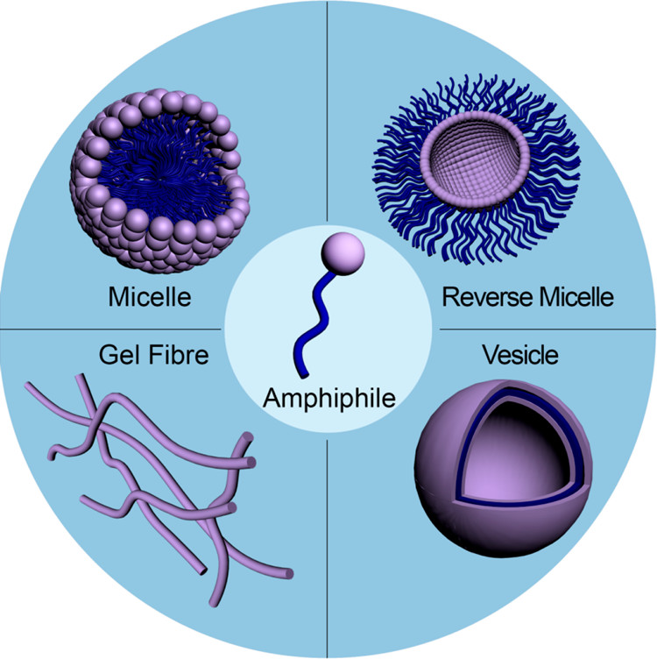
Self-Assembly and Applications of Amphiphilic Polymers
Gounaris Nikolaidis Dimitrios
Registration Number:1057
27/04/2020

Slide 2
Outline
Self Assembly
Different Phases formed by Self-Assembly
Polymeric Vesicles-Polymersomes
Temperature-Responsive Polymersomes for Drug Delivery
Protein-Polymer Conjugates
Single-Chain Polymeric Nanoparticles (SCPN)

Slide 3
Self Assembly
Self Assembly is the spontaneous organization of pre-existing components into structurally well-defined arrangements of high order and complexity through a number of noncovalent interactions:
Hydrophobic Interactions
π-π Stacking
Hydrogen bonds
Van der Waals Forces
Electrostatic interactions
Although each of the bonds is rather weak, the collective interactions can result in very stable structures and materials.

Slide 4
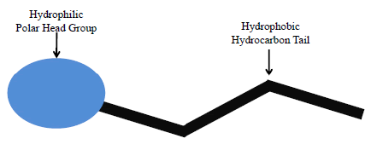
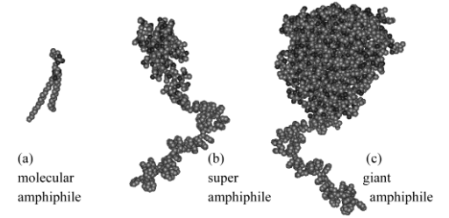
Self Assembly
The basic building blocks of self-assembled Structures:
Classes of Amphiphilic Molecules:
Bhargav K.S, A. R. M. Updated Review on Micellar Electro Κinetic Chromatography. J. Chromatogr. Sep. Tech. 05, (2014).
Velonia, K., Rowan, A. E. & Nolte, R. J. M. Lipase Polystyrene Giant Amphiphiles. J. Am. Chem. Soc. 124, 4224–4225 (2002).

Slide 5
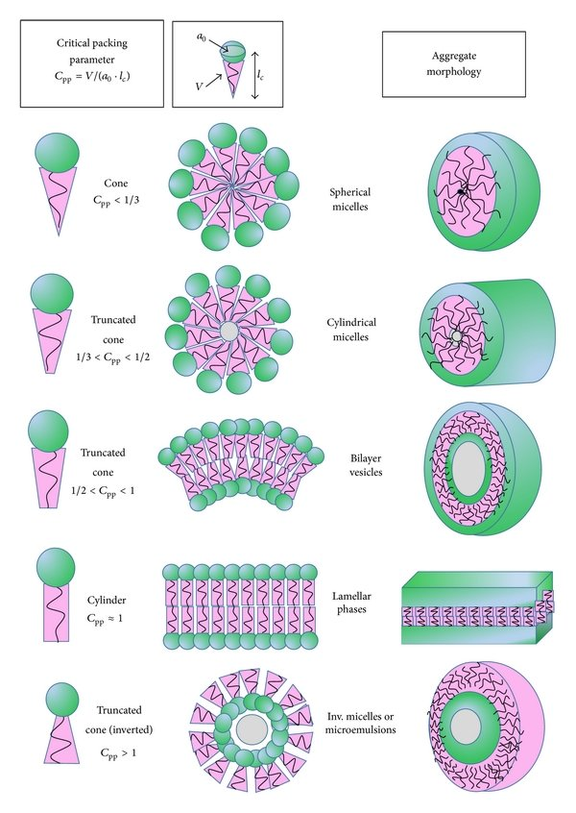
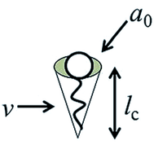

Different Phases formed by Self-Assembly
(Critical Packing Parameter)
Lombardo, D., Kiselev, M. A., Magazù, S. & Calandra, P. Amphiphiles Self-Assembly: Basic Concepts and Future Perspectives of Supramolecular Approaches. Advances in Condensed Matter Physics 2015, 151683 (2015).
https://www.stevenabbott.co.uk/practical-surfactants/cpp.php

Slide 6
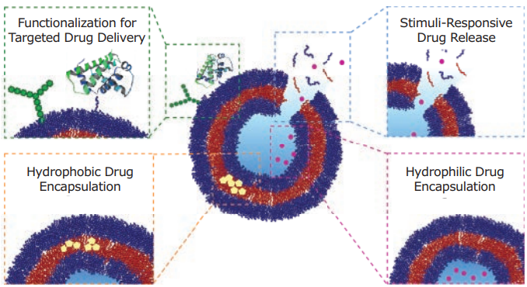
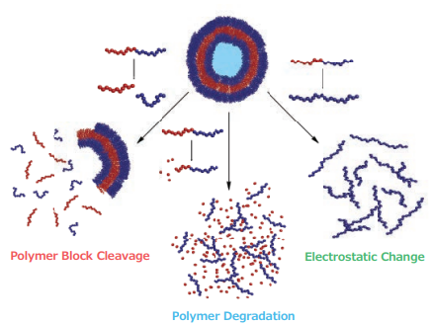
Polymeric Vesicles-Polymersomes
Advantages
Drug Release
Joe Collins, Ayana Bhaskaran, Luke Andrew Connal, Material Matters, 2017 Volume 12, Number 2

Slide 7
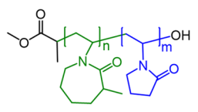
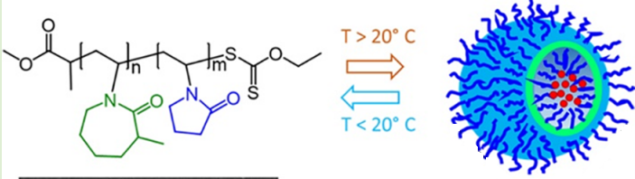
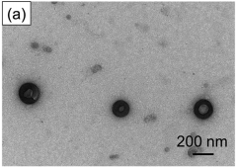
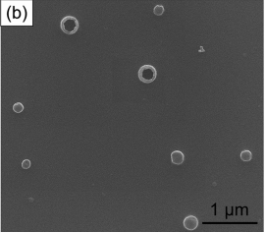
Temperature-Responsive Polymersomes of PMVC_{m}-PVPON_{n}
LCST between 15°C and 19°C
Narrow Size Distributions
TEM and SEM Images
Kozlovskaya, V. et al. Temperature-Responsive Polymersomes of Poly(3-methyl- N -vinylcaprolactam)- block -poly( N -vinylpyrrolidone) To Decrease Doxorubicin-Induced Cardiotoxicity. Biomacromolecules 20, 3989–4000 (2019).

Slide 8
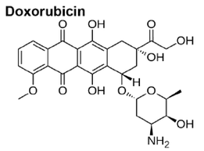
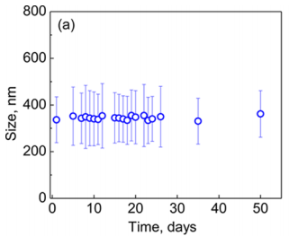
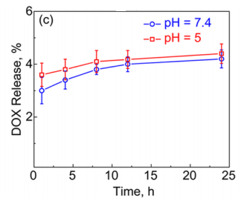
Drug Encapsulation
Time-Dependent Size Stability
Time-Dependent Release of DOX
Kozlovskaya, V. et al. Temperature-Responsive Polymersomes of Poly(3-methyl- N -vinylcaprolactam)- block -poly( N -vinylpyrrolidone) To Decrease Doxorubicin-Induced Cardiotoxicity. Biomacromolecules 20, 3989–4000 (2019).

Slide 9
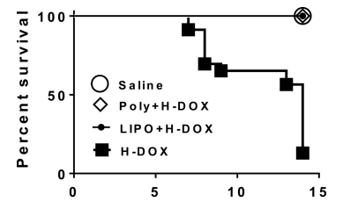
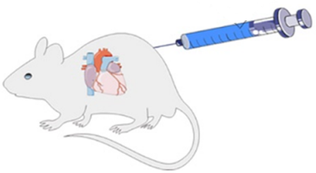
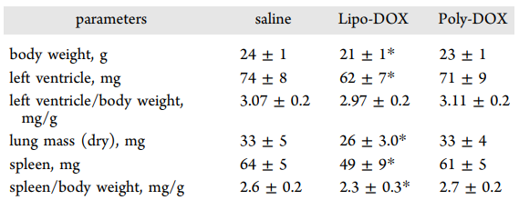
Animal Experiments
Kozlovskaya, V. et al. Temperature-Responsive Polymersomes of Poly(3-methyl- N -vinylcaprolactam)- block -poly( N -vinylpyrrolidone) To Decrease Doxorubicin-Induced Cardiotoxicity. Biomacromolecules 20, 3989–4000 (2019).

Slide 10
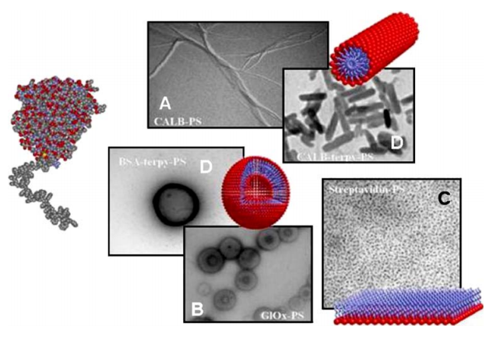
Protein-Polymer Conjugates
Thordarson, P., Le Droumaguet, B. & Velonia, K. Well-defined protein–polymer conjugates—synthesis and potential applications. Appl. Microbiol. Biotechnol. 73, 243–254 (2006).

Slide 11
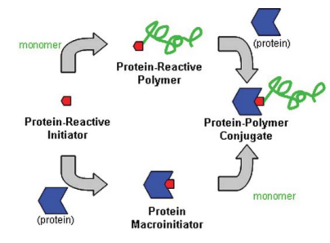
Routes to Protein-Polymer Conjugates
Grafting To
Grafting From
Independent synthesis of polymer chain
Conjugation of the polymer chain to the protein
Selective modification of the protein with an initiator (Bio-Initiator)
Generating polymers directly from proteins at defined initiation sites
Limitations of reactions between macromolecules → Low Yields
Heredia, K. L. & Maynard, H. D. Synthesis of Protein–Polymer Conjugates. Org Biomol Chem 5, 45–53 (2007)

Slide 12
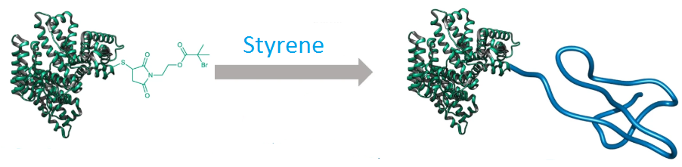
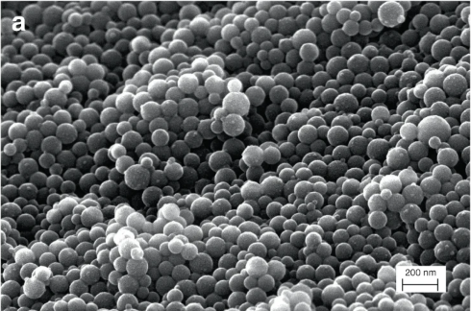
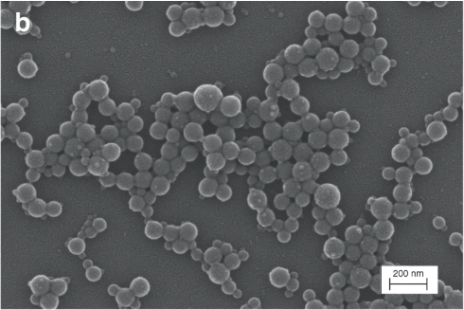
BSA-PS
Well-defined and uniform spherical superstructures
Diameters between 80 and 130 nm
Theodorou, A. et al. Protein-polymer bioconjugates via a versatile oxygen tolerant photoinduced controlled radical polymerization approach. Nature Communications 11, 1486 (2020).

Slide 13
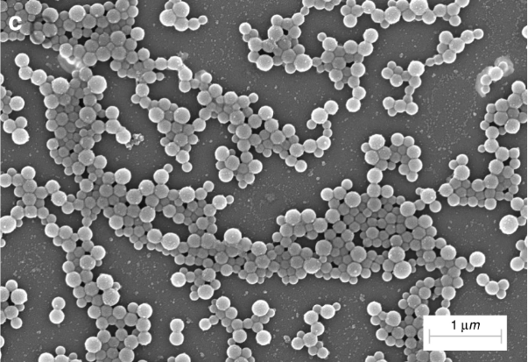
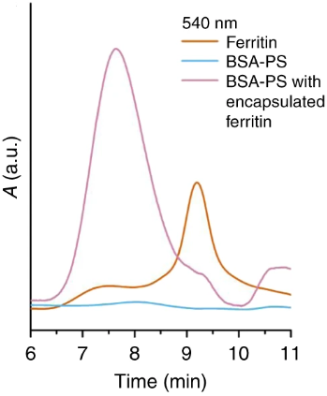
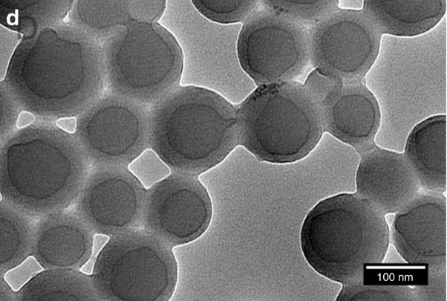
BSA-PS nanocarriers-ferritin encapsulation
SEC traces at 540 nm
Theodorou, A. et al. Protein-polymer bioconjugates via a versatile oxygen tolerant photoinduced controlled radical polymerization approach. Nature Communications 11, 1486 (2020).

Slide 14
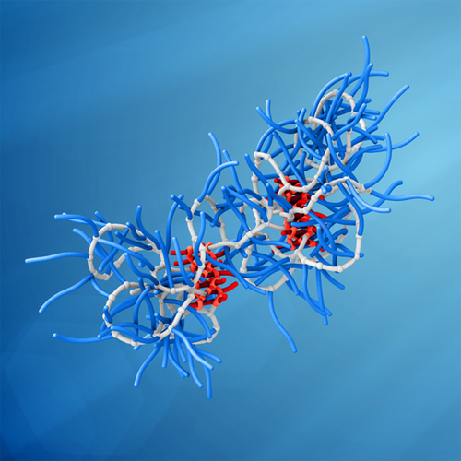
Supramolecular Single-Chain Polymeric Nanoparticles (SCPN)
Supramolecular Single-Chain Polymeric Nanoparticles, Gijs M. ter Huume, Anja R.A Palmans, and E. W. Meijer , CCS Chem. 2019, 1, 64–82

Slide 15
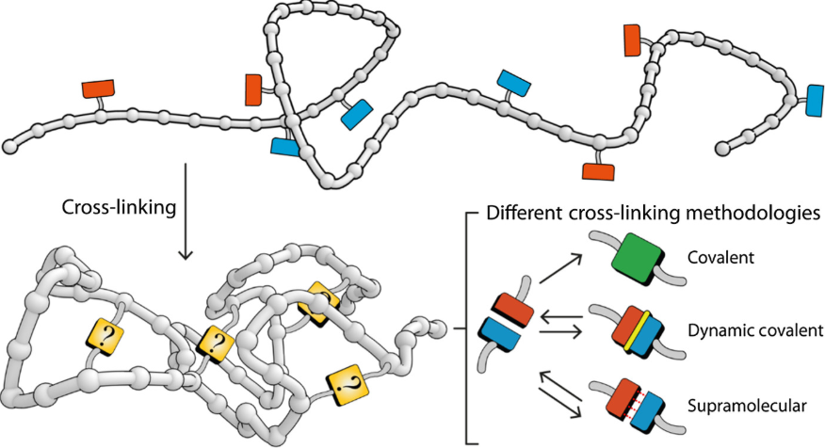
Producing SCPN by Applying Intramolecular Cross-linking Reactions
Supramolecular Single-Chain Polymeric Nanoparticles, Gijs M. ter Huume, Anja R.A Palmans, and E. W. Meijer , CCS Chem. 2019, 1, 64–82

Slide 16
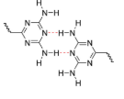
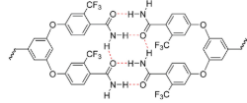
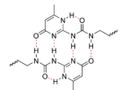
Folding Polymers via Hydrogen-bond-driven Dimerization
Rotelo and co-workers
(1999)
Kim and co-workers
(2008)
Meijer and co-workers
(2013)
Supramolecular Single-Chain Polymeric Nanoparticles, Gijs M. ter Huume, Anja R.A Palmans, and E. W. Meijer , CCS Chem. 2019, 1, 64–82

Slide 17
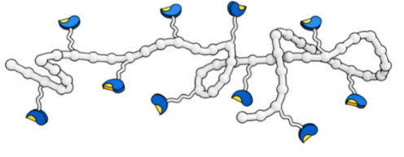

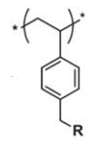
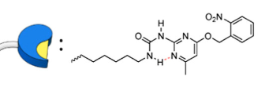
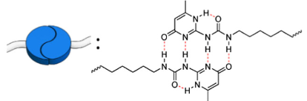
Folding Polymers via Hydrogen-bond-driven Dimerization
OR
hv
O-nitrobenzyl-protected 2-ureido-pyrimidinone (Upy)
Stals, P. J. M., Gillissen, M. A. J., Nicolaÿ, R., Palmans, A. R. A. & Meijer, E. W. The balance between intramolecular hydrogen bonding, polymer solubility and rigidity in single-chain polymeric nanoparticles. Polym. Chem. 4, 2584 (2013).

Slide 18
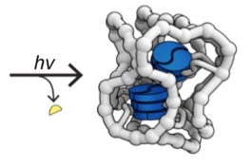
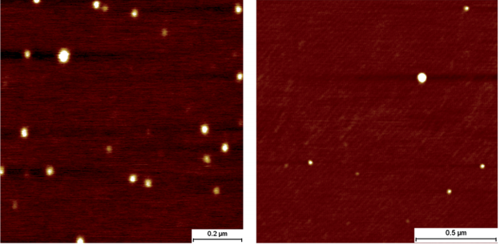
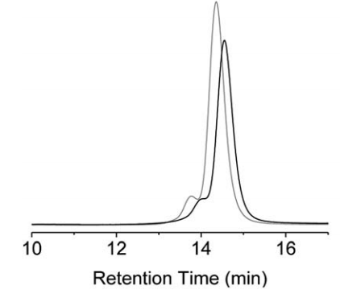
Folding Polymers via Hydrogen-bond-driven Dimerization
Nanoparticles with a 25-30nm diameter
SEC measurements
Stals, P. J. M., Gillissen, M. A. J., Nicolaÿ, R., Palmans, A. R. A. & Meijer, E. W. The balance between intramolecular hydrogen bonding, polymer solubility and rigidity in single-chain polymeric nanoparticles. Polym. Chem. 4, 2584 (2013).

Slide 19
Bibliography
Velonia, K., Rowan, A. E. & Nolte, R. J. M. Lipase Polystyrene Giant Amphiphiles. J. Am. Chem. Soc. 124, 4224–4225 (2002).
Bhargav K.S, A. R. M. Updated Review on Micellar Electro Κinetic Chromatography. J. Chromatogr. Sep. Tech. 05, (2014).
Lombardo, D., Kiselev, M. A., Magazù, S. & Calandra, P. Amphiphiles Self-Assembly: Basic Concepts and Future Perspectives of Supramolecular Approaches. Advances in Condensed Matter Physics 2015, 151683 (2015).
Theodorou, A. et al. Protein-polymer bioconjugates via a versatile oxygen tolerant photoinduced controlled radical polymerization approach. Nature Communications 11, 1486 (2020).
Heredia, K. L. & Maynard, H. D. Synthesis of Protein–Polymer Conjugates. Org Biomol Chem 5, 45–53 (2007)
Thordarson, P., Le Droumaguet, B. & Velonia, K. Well-defined protein–polymer conjugates—synthesis and potential applications. Appl. Microbiol. Biotechnol. 73, 243–254 (2006).
Kozlovskaya, V. et al. Temperature-Responsive Polymersomes of Poly(3-methyl- N -vinylcaprolactam)- block -poly( N -vinylpyrrolidone) To Decrease Doxorubicin-Induced Cardiotoxicity. Biomacromolecules 20, 3989–4000 (2019).
Joe Collins, Ayana Bhaskaran, Luke Andrew Connal, Material Matters, 2017 Volume 12, Number 2
Sarkar et al., “Tailor-Made Self-Assemblies from Functionalized Amphiphiles: Diversity and Applications”, ACS Pub, 2018
Stals, P. J. M., Gillissen, M. A. J., Nicolaÿ, R., Palmans, A. R. A. & Meijer, E. W. The balance between intramolecular hydrogen bonding, polymer solubility and rigidity in single-chain polymeric nanoparticles. Polym. Chem. 4, 2584 (2013).

Slide 20
Thank you

